Slide 1
Chapter 16. Applying Patterns to Design a State Diagram Editor

Slide 2
Abstract Factory

Slide 3
Intent
Provide an interface for creating families of related or dependent objects without specifying their concrete classes.
16-<number>

Slide 4
Also Known As
Kit
16-<number>

Slide 5
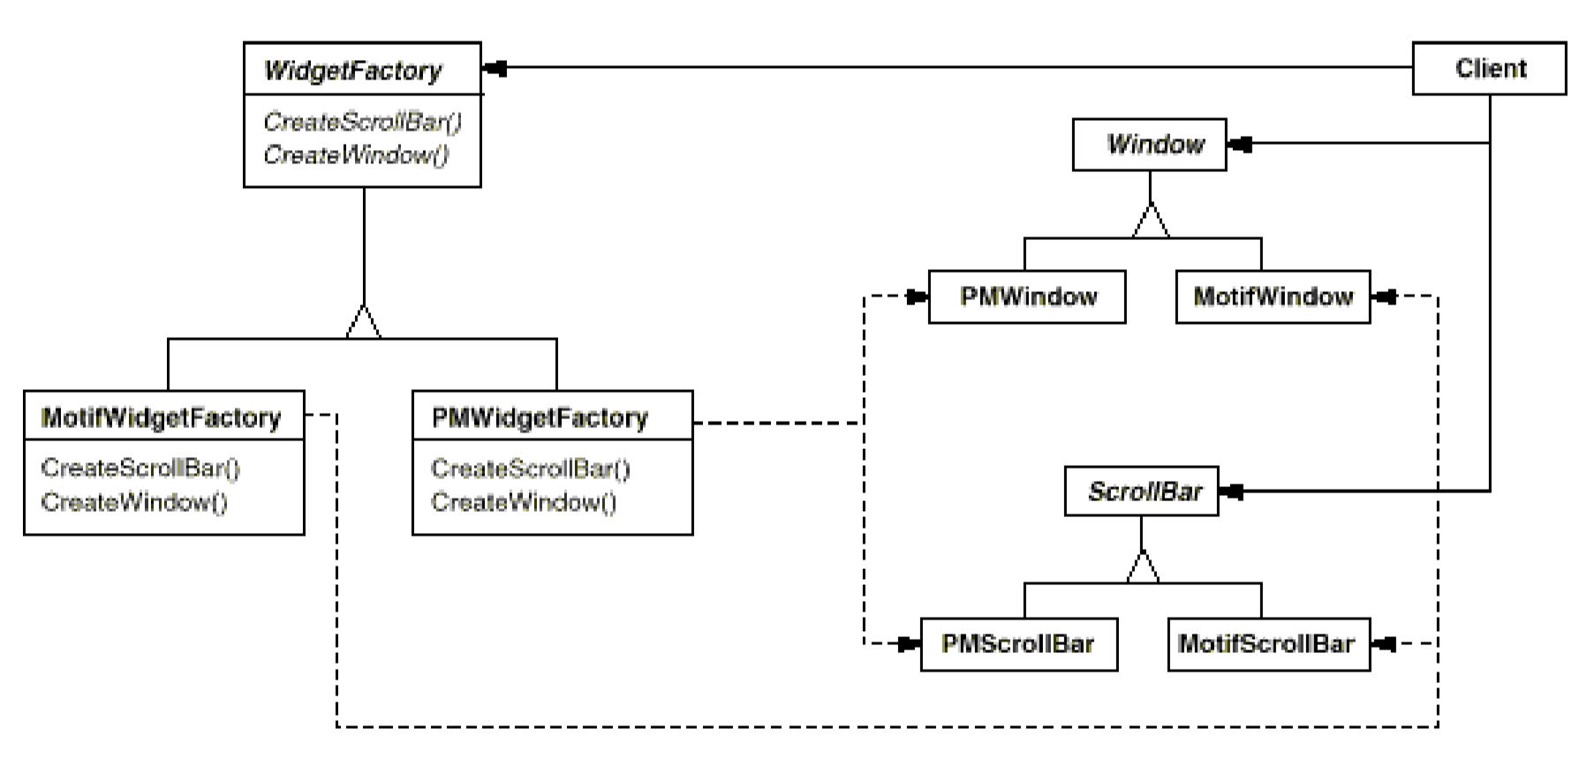
Motivation
Consider a user interface toolkit that supports multiple look-and-feel standards, such as Motif and Presentation Manager. Different look-and-feels define different appearances and behaviors for user interface "widgets" like scroll bars, windows, and button.
To be portable across look-and-feel standards, an application should not hard-code its widgets for a particular look and feel.
13-<number>

Slide 6
Applicability
Use the Abstract Factory pattern when
a system should be independent of how its products are created, composed, and represented.
a system should be configured with one of multiple families of products.
a family of related product objects is designed to be used together, and you need to enforce this constraint.
you want to provide a class library of products, and you want to reveal just their interfaces, not their implementations.
16-<number>

Slide 7
Structure
Normally a single instance of a ConcreteFactory class is created at run-time. This concrete factory creates product objects having a particular implementation. To create different product objects, clients should use a different concrete factory.
AbstractFactory defers creation of product objects to its ConcreteFactory subclass.
17-<number>

Slide 8
Abstract Factory
Provide an interface for creating families of related or dependent objects without specifying their concrete classes.
It is similar to Factory Pattern except the fact that it’s more like factory of factories.
16-<number>

Slide 9
Supporting Various UML Versions
The diagram editor should support UML 1.0 and UML 2.0.
A commonly used approaches:
  use conditional statements to determine how the modeling constructs according to versions selected
  let the client determine modeling constructs of a UML version should be created:
if (choice=“UML1.0") {
  state=new UML1State();
  transition=new UML1Transition();
  ...
  } else
  if (choice=“UML2.0") {
  ...
  }
16-<number>

Slide 10
Problems with Common Practice
Using conditional statements creates a maintenance nightmare:
  Similar conditional statements appear everywhere.
  To add, delete or change a UML modeling construct, many places must be changed.
  To support a new version such UML 3.0, a conditional branch must be added to all the conditional statements.
  To delete or change an existing UML version, many places must be changed.
  The implementation is complex, bulky and buggy.
All above invites tedious work, inconsistency and grief.
16-<number>

Slide 11
What Is the Solution?
The conditional statement suggests use of inheritance – subclasses replace conditional branches.
How to accomplish this?
  since the versions differ in notations, one may treat the versions as subclasses
  one may let each version subclass create the modeling constructs for the given version
  the result is an application of the Abstract Factory pattern
16-<number>

Slide 12
Abstract Factory
Factory hierarchy
Client holds a
reference to a
factory
Typical interface:
createX():X, createY():Y
createState(p:Point):State
createTransition(p:Point):Transition
createDiagram():StateDiagram
...
Client
UML Factory
return new
UML2State();
create
return new
UML1State();
factory
createState(p:Point):State
createTransition(p:Point):Transition
createDiagram():StateDiagram
...
createState(p:Point):State
createTransition(p:Point):Transition
createDiagram():StateDiagram
...
UML 1.0 Factory
UML 2.0 Factory
Product hierarchy
Diagram Element
*
State
Transition
State Diagram
UML1 State
UML2 State
UML1 ...
UML2 ...
UML1 ...
UML2 ...
16-<number>

Slide 13
Object Interaction in Abstract Factory
setFactory (f:AbstractFactory)
client:
factory:Abstract Factory
x:X
foo()
x :=createX(): X
create()
ba()
The concrete factory
determines which
brand of objects will
be created.
16-<number>

Slide 14
Example of Abstract Factory and Factory design pattern
DocumentBuilderFactory abstractFactory = DocumentBuilderFactory.newInstance();
DocumentBuilder factory = abstractFactory.newDocumentBuilder();
Document doc = factory.parse(stocks)
In this example DocumentBuilderFactory (Abstract Factory) creates DocumentBuilder (Factory) which creates Documents (Products).
16-<number>

Slide 15
Abstract Factory
Benefits:
  It provides an uniform interface for the client to creating products of different families.
  A concrete factory is responsible for creating products of a given family. It makes exchanging product families easy. It is easy to add new families of products, provided that they share the same interface
  Changing the concrete factory changes the family of products created. It promotes consistency among products.
  .
16-<number>

Slide 16
Abstract Factory
Liabilities
  Supporting new kinds of products is difficult. It is not easy to add a new family of products that require a different product creation interface.
  The concrete factories are responsible for enforcing the consistency among the products created.
16-<number>

Slide 17
Abstract Factory and Related Patterns
Factory method, prototype, and builder can be used to implement abstract factory.
Reusing prototypes to improve object creation efficiency.
Abstract Factory
These are factory methods.
Prototype Mgr
createX(): X
createY(): Y
get(key): Object
Concrete factories can be singletons.
Concrete Factory 1
Concrete Factory 2
createX(): X
createY(): Y
createX(): X
createY(): Y
Builder can implement create methods.
16-<number>

Slide 18
Abstract Factory and Builder
Abstract factory is concerned with the creation of similar products of different brands.
Builder can use abstract factory to vary the parts used by the build steps. Abstract factory can use builder to build products that need to vary the processes and steps.
16-<number>

Slide 19
Builder and Factory Method
Supervisor
Builder
create(b: Builder)
construct()
buildX()
buildY()
getResult():Product
builder
Supervisor 1
Supervisor 2
Builder 1
Builder 2
create(b: Builder)
construct()
create(b: Builder)
construct()
buildX()
buildY()
buildX()
buildY()
template method that
calls the factory methods
Builder can change the
construction process.
Factory
Construct()
buildX():X
buildY():Y
factory methods
Factory method cannot.
Factory 1
Factory 2
buildX():X
buildY():Y
buildX():X
buildY():Y
Both can change the
construction steps.
16-<number>

Slide 20
Persistence Framework: Putting It Together
Controller
DBMgr
DB Access Interface
Net Interface
getX(): X
saveX(x:X)
getX(): X
saveX(x:X)
openSocket()
closeSocket()
calls hook1() and hook2()
DBX Cmd
DBX Access
DBY Proxy
Remote DBY
execute(): Object
hook1()
hook2(): Object
getX(): X
saveX(x:X)
getX(): X
saveX(x:X)
openSocket()
closeSocket()
getX(): X
saveX(x:X)
openSocket()
closeSocket()
bridge
Get X
Save X
remote proxy
GetX(...)
hook1()
hook2(): Object
SaveX(...)
hook1()
hook2(): Object
command, template method and factory method
17-<number>

